Slide 1


Slide 2

Prediction of Heart Disease
The article [1] presents a comprehensive analysis of heart disease prediction through a combination of machine learning and deep learning techniques.
It emphasizes the significance of accurate prediction models in healthcare, detailing the use of various algorithms to analyze heart disease data.
[1] R. Bharti, A. Khamparia, M. Shabaz, G. Dhiman, S. Pande, and P. Singh, "Prediction of heart disease using a combination of machine learning and deep learning," Computational intelligence and neuroscience, vol. 2021, 2021.

Slide 3
Visualization and Summarization
The project was underpinned by a thorough preprocessing phase, which addressed outliers and duplicate entries, thereby refining the dataset for more accurate analysis.
Visualization techniques such as bar charts, pie charts, histograms, scatter plots, QQ plots, box plots, and heatmaps offered profound insights into the distribution and relationships between variables, highlighting potential predictors of heart disease.

Slide 4
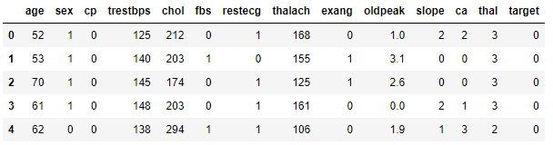
Visualization and Summarization
Dataset
The researchers used the "Public Health Dataset" created in 1988, which combines data from four sources (Cleveland, Hungary, Switzerland, and Long Beach V).
It has 76 different pieces of information about each patient, but most studies only use 14 specific ones.

Slide 5
Visualization and Summarization
Preprocessing
Outlier Detection and Removal
Distribution Balancing
Skewness Correction
Duplicate Value Detection and Removal
Original Dataset Size: 1025 entries
After Outlier Removal: Reduced to 976 entries
After Duplicate Removal: 288 unique entries

Slide 6
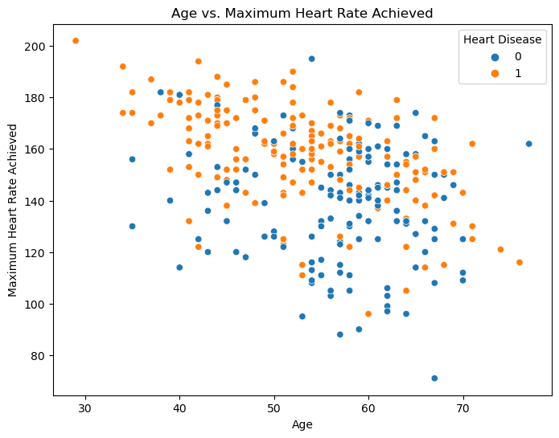
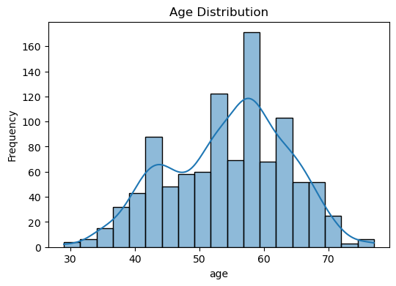
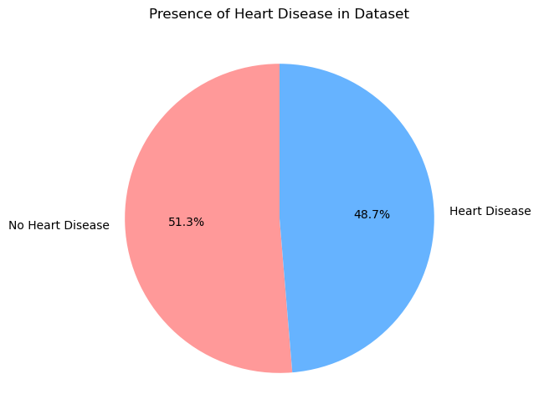
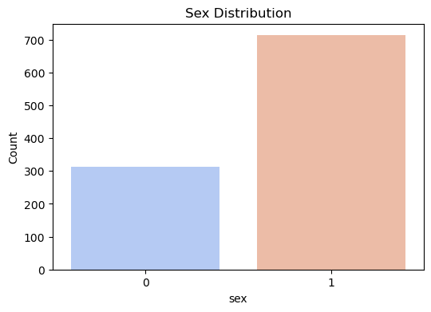
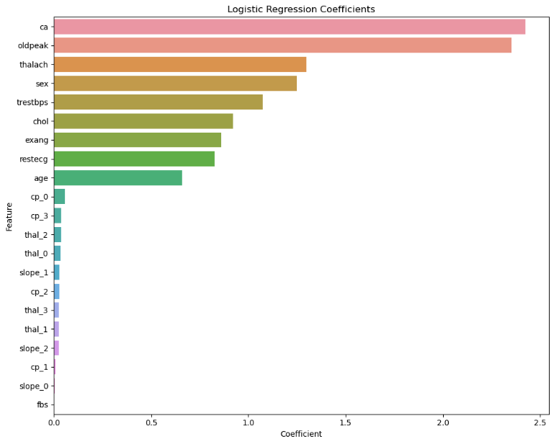
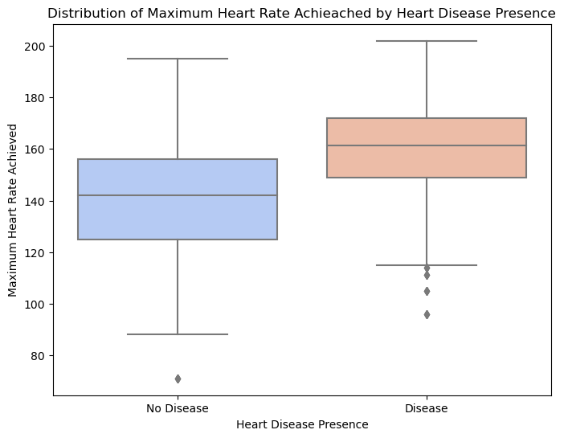
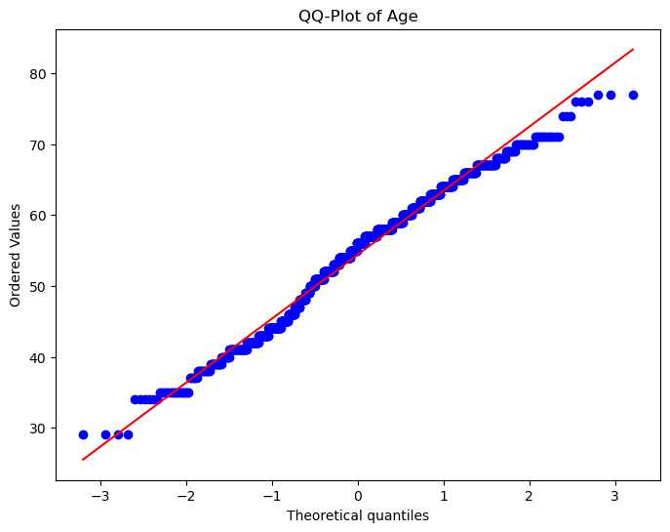
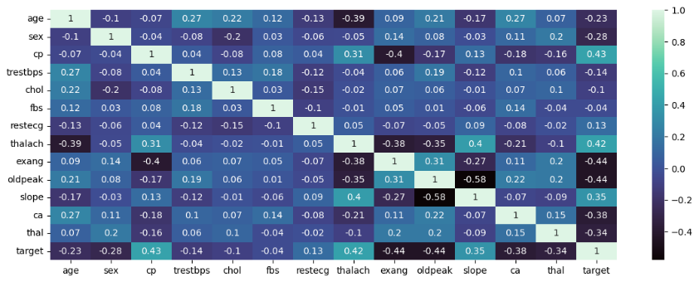
Visualization and Summarization
Visualization
  Identify dependent and independent factors

Slide 7
Visualization and Summarization
Kolmogorov Smirnov Test
The KS test is a non-parametric test that compares a sample with a reference probability distribution or compares two samples. In this context, we're interested in testing if the age distribution in the dataset follows a normal distribution.
The P-value is significantly low(4.22*10^(-6)) far below the common significance level of 0.05 used to assess statistical significance.
This means there is statistically significant evidence that the age data deviates from normality.

Slide 8
Parametric Inference and Estimation
Our methodological framework spanned various statistical tests and inference techniques, including the Shapiro–Wilk test, T-tests, the Jarque-Bera test, F-tests, and the Wilcoxon-Mann-Whitney test, among others.
These methods allowed us to rigorously test hypotheses related to the normality of data distributions, differences in mean and median values across groups, and the association between categorical and continuous variables.

Slide 9
Parametric Inference and Estimation
Checking Normality
Shapiro–Wilk test
The Shapiro-Wilk test on the chol variable yielded a test statistic of approximately 0.950. The extremely small p-value suggests that we can reject the null hypothesis of normality for the chol (the serum cholesterol) dataset. Then we should do a transformation to apply parametric test on this data.

Slide 10
Parametric Inference and Estimation
Checking Normality
Jarque-Bera test
The Jarque-Bera test is a statistical test that checks whether sample data have the skewness and kurtosis matching a normal distribution. It's particularly useful for large samples, as its power increases with the sample size.
The very small p-value 1.426×10^10 suggests that we can reject the null hypothesis of normality for the thalach (the maximum heart rate achieved). So we should do transformation to dataset before apply parametric test.

Slide 11
Parametric Inference and Estimation
T-test
A potential hypothesis could involve comparing the maximum heart rate achieved between individuals with and without heart disease
The results of the independent t-test for the maximum heart rate achieved (thalach) show a test statistic of approximately 14.86 and a p-value of approximately 3.42e-45.
Based on the t-test, we reject the null hypothesis and conclude that there is a statistically significant difference in the mean maximum heart rate achieved between individuals with heart disease and those without in the provided dataset

Slide 12
Parametric Inference and Estimation
T-test
The results of the t-test would provide a p-value indicating whether there's a statistically significant difference in the mean Cholesterol level between individuals with and without heart disease.
The results of the independent t-test show a test statistic of approximately -3.22 and a p-value of approximately 0.0013.
The p-value is less than the commonly used significance level of 0.05, which suggests that we have enough evidence to reject the null hypothesis

Slide 13
Parametric Inference and Estimation
F-test
We'll use the resting blood pressure (trestbps) for this variance test, comparing individuals with heart disease to those without.
The F-statistic (ratio of variances) is approximately 0.752.
These results indicate that the variance of resting blood pressure in individuals without heart disease is less than that of individuals with heart disease, as shown by an F-statistic less than 1.

Slide 14
Parametric Inference and Estimation
Proportion Test
Exercise-induced angina is chest pain occurring during physical activity due to insufficient heart muscle oxygenation, potentially indicating narrowed or blocked coronary arteries
For large values of n we can use the normal approximation to the binomial distribution. The results of the two-proportion z-test show a test statistic of approximately -14.02 and a p-value of approximately 1.12e-44.
This result suggests that the experience of exercise-induced angina is associated with the presence of heart disease, supporting the alternative hypothesis.

Slide 15
Parametric Inference and Estimation
NonParametric: Wilcoxon-Mann-Whitney-Test
Given that the data are not strictly normal even after transformation, we also use non-parametric tests.
used to compare whether there is a difference in the median values of two independent groups.
The Wilcoxon Mann-Whitney test comparing serum cholesterol (chol) levels between males and females yielded a U statistic of approximately 89877.0 and a p-value of approximately 9.79*10^(-7).
Based on the Wilcoxon Mann-Whitney test results, there is a statistically significant difference in serum cholesterol levels between males and females in dataset.

Slide 16
Parametric Inference and Estimation
Estimation of parameters
Point estimation: Mean Resting Blood Pressure
Mean Resting Blood Pressure (trestbps): The point estimate is approximately 131.61 mmHg.
The 95% confidence interval is approximately 130.54 to 132.68 mmHg
Point estimation: Mean Cholesterol Level
Mean Cholesterol Level (chol): The point estimate is 246.00 mg/dL.
The 95% confidence interval is approximately 242.84 to 249.16 mg/dL.

Slide 17
Parametric Inference and Estimation
Maximum likelihood estimation
Given the estimated parameters for the serum cholesterol (chol) variable from dataset using Maximum Likelihood Estimation (MLE), we have:
Mean estimate: 246.0 mg/dL
Standard deviation estimate: 51.567 mg/dL
Understanding the distribution of cholesterol levels within a population can have significant clinical implications. For instance, high cholesterol levels are a known risk factor for heart disease. The American Heart Association suggests that adults should aim for a cholesterol level lower than 200 mg/dL.

Slide 18
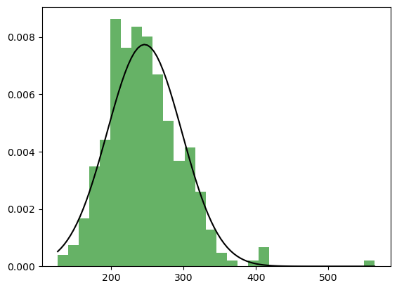
Parametric Inference and Estimation
Maximum likelihood estimation
To understand how well the estimated parameters fit data, we can plot the histogram of chol data alongside the probability density function (PDF) of a normal distribution with the estimated parameters:

Slide 19
Parametric Inference and Estimation
Checking for missing or unobserved data points
Interpolation is a method of estimating and constructing new data points within the range of a discrete set of known data points. It's particularly useful in handling missing or unobserved data within datasets.
The dataset does not have any missing data across all its variables. Each column has zero missing values, indicating that the dataset is complete and no interpolation for missing data is necessary.

Slide 20
Hypothesis Testing and Statistical Analysis
Here, I employed a series of sophisticated statistical tests to validate our assumptions and hypotheses regarding the data. This included employing the Chi-square test for independence, revealing significant relationships between categorical variables and heart disease. ANOVA and Kruskal-Wallis tests were instrumental in identifying differences among multiple groups.

Slide 21
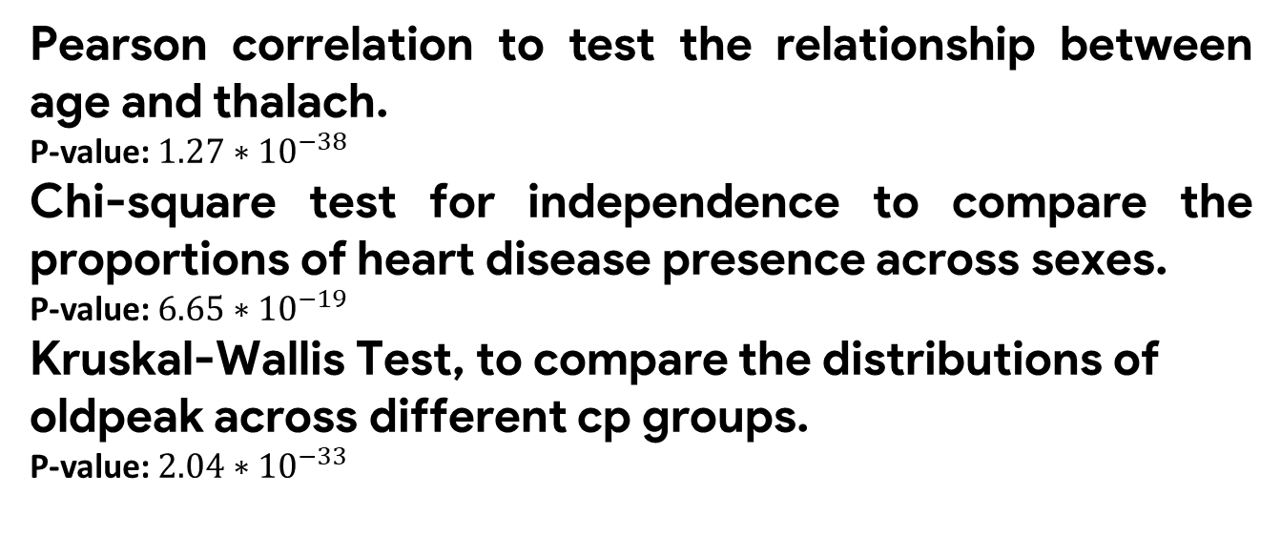
Hypothesis Testing and Statistical Analysis
Hypothesis Testing
Pearson correlation to test the relationship between age and thalach.
P-value: $1.27∗{10}^{−38}$
Chi-square test for independence to compare the proportions of heart disease presence across sexes.
P-value: $6.65∗{10}^{−19}$
Kruskal-Wallis Test, to compare the distributions of oldpeak across different cp groups.
P-value: $2.04∗{10}^{−33}$
ST depression refers to a specific abnormality seen on an electrocardiogram (ECG), a test that measures the electrical activity of the heart. In an ECG, there are several waves and segments that represent different phases of the heartbeat

Slide 22
Hypothesis Testing and Statistical Analysis
Bootstrap Method for Hypothesis Testing
It allows for hypothesis testing, especially useful in cases where the data distribution is unknown, non-normal, or when the sample size is small.
We apply the bootstrap method for hypothesis testing on the dataset to compare the average maximum heart rate achieved (thalach) between two groups defined by the presence of heart disease.
This choice is motivated by the clinical relevance of examining how heart disease might affect physical indicators like heart rate.
The Result suggests that there is a statistically significant difference in the mean maximum heart rate achieved between individuals with and without heart disease.

Slide 23
Hypothesis Testing and Statistical Analysis
Resampling Method for Hypothesis Testing
Permutation Test
The permutation test is a resampling method that involves combining the data from both groups, shuffling (or permuting) the combined data, and then reallocating the shuffled data into two groups to test the hypothesis. This method does not assume normal distribution and is suitable for non-parametric data.
The Result suggests that there is a statistically significant difference in the median oldpeak between individuals with and without heart disease.

Slide 24
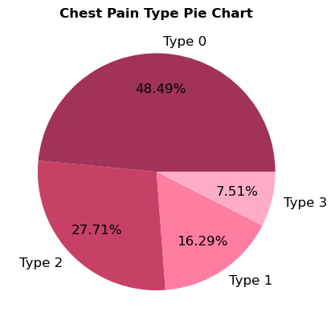
Hypothesis Testing and Statistical Analysis
ANOVA
To conduct an Analysis of Variance (ANOVA) test, we need to compare the means of different groups within a continuous variable across different levels of a categorical variable.
We can choose cp (chest pain type) as the categorical variable for grouping and thalach (maximum heart rate achieved) as the continuous variable to compare across these groups.

Slide 25
Hypothesis Testing and Statistical Analysis
ANOVA
Null Hypothesis (H0): There are no differences in the mean maximum heart rate achieved (thalach) among the different types of chest pain (cp).
F-Statistic: 62.86
P-value: 2.67∗10−37
At least one type of chest pain is associated with a distinct mean maximum heart rate when compared to the others.

Slide 26
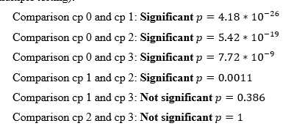
Hypothesis Testing and Statistical Analysis
Bonferroni Method
When you conduct ANOVA and find a significant result, it indicates that there are differences among the group means, but it doesn't specify which groups differ from each other.

Slide 27
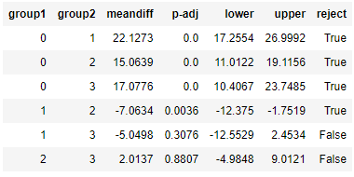
Hypothesis Testing and Statistical Analysis
Tukey's Method
The results from Tukey's HSD test for comparing the mean maximum heart rate achieved (thalach) across different chest pain types (cp) are as follows:

Slide 28
Regression Analysis and Reporting
Regression analysis, both simple linear and logistic, played a pivotal role in our investigation, enabling us to predict the likelihood of heart disease based on key predictors.

Slide 29
Regression Analysis and Reporting
Simple Linear Regression
For a simple linear regression analysis, we aim to investigate the relationship between two variables. A common choice in the context of heart disease could be analyzing how a continuous predictor variable, such as age, trestbps (resting blood pressure), chol (cholesterol level), or thalach (maximum heart rate achieved), affects the likelihood of heart disease (target).
In this part we explore the relationship between age and thalach (maximum heart rate achieved)

Slide 30
Regression Analysis and Reporting
Simple Linear Regression
The simple linear regression analysis between age and thalach (maximum heart rate achieved) resulted in the following linear equation:
thalach=202.98-0.99×age
R-squared = 0.1523: This value explains the proportion of the variance in the maximum heart rate that is predictable from the age of individuals. With a value of approximately 0.15, it suggests that age alone explains about 15% of the variance in maximum heart rate. This indicates a weak to moderate relationship between age and maximum heart rate, suggesting that other factors also play significant roles in determining the maximum heart rate.

Slide 31
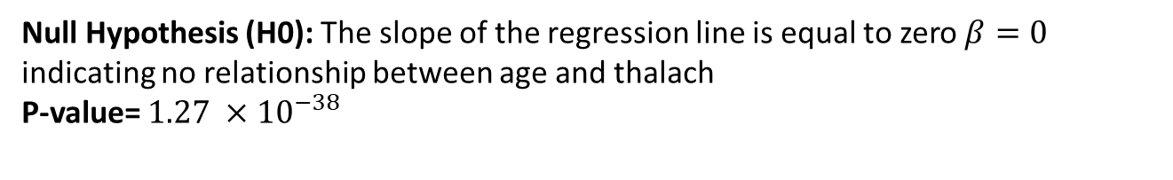
Regression Analysis and Reporting
Hypothesis Testing for SLR
Null Hypothesis (H0): The slope of the regression line is equal to zero $β=0$ indicating no relationship between age and thalach
P-value= $1.27 ×10^{−38}$
The rejection of the null hypothesis (H0) in the hypothesis testing for the simple linear regression between age and thalach indicates that there is a statistically significant relationship between these two variables. However, the statistical significance of the relationship does not necessarily imply that the model is a good predictor.

Slide 32
Regression Analysis and Reporting
Logestic Regression
For this logistic regression we choose variables that are commonly associated with heart disease and are continuous.
The variables selected are: age – chol – thalach – trestbps
These variables will be the predictors in our logistic regression model, with target as the outcome variable.
Model Accuracy: 68%
The model's accuracy of 68% suggests it can correctly predict the presence of heart disease 68% of the time, which is decent but indicates room for improvement.

Slide 33
Regression Analysis and Reporting
Analysis of Regression findings from the publication
The publication demonstrates the effectiveness of combining machine learning and deep learning techniques for predicting heart disease.
By applying different machine learning algorithms and then using deep learning to see what difference comes when it is applied to the data, three approaches were used.
In the first approach, normal dataset which is acquired is directly used for classification, and in the second approach, the data with feature selection are taken care of and there is no outliers detection. The results which are achieved are quite promising and then in the third approach the dataset was normalized taking care of the outliers and feature selection
First approach accuracy for Logistic Regression is 83.64%
Second approach accuracy for Logistic Regression is 85.9%
Third approach accuracy for Logistic Regression is 83.31%

Slide 34
Regression Analysis and Reporting
Feature selection and Logestic Regression
By reducing noise and complexity, the logistic regression model could more efficiently identify the relationships between features and the outcome variable (presence of heart disease).
This approach strikes a balance between data simplification (through feature selection) and maintaining the dataset's original structure (without outlier removal or normalization)
The effectiveness of preprocessing techniques can vary widely depending on the specific characteristics of the dataset, the nature of the outliers, and the prediction task at hand. In this scenario, feature selection without outlier detection proved to be the most effective strategy, likely because it preserved useful variance in the data that was crucial for making accurate predictions about heart disease.

Slide 35
Regression Analysis and Reporting
Logestic Regression after Preprocessing
We initiated our process by transforming categorical variables such as 'cp' (chest pain type), 'thal' (thalassemia), and 'slope' (the slope of the peak exercise ST segment) into numerical representations using one-hot encoding.
Further refining our dataset, we applied the MinMaxScaler to normalize the feature set, ensuring that each variable contributed equally to the analysis without being overshadowed by the scale of others.
The culmination of these methodical preprocessing steps and logistic regression analysis yielded an impressive accuracy of 84%.

Slide 36
Regression Analysis and Reporting
Coefficients of the logistic regression
These coefficients help us understand which features are most influential in predicting heart disease and in what direction they influence the prediction.

Slide 37
COMPREHENSIVE REPORT
Visualization and Summarization of Dataset Variables
Approach | N | Description
1.Preprocessing | 2 | Outlier Removal - Duplicate Removal
2.Bar Charts | 2 | Sex Distribution - Heart Disease Distribution
3.Pie Charts | 2 | Target Distribution – Chest Pain Type
4.Histograms | 5 | Age Distribution – Serum Cholesterol Distribution – Max Heartrate Distribution - MLE
5.Scatter Plots | 1 | Age vs Max Heartrate
6.QQ Plot | 1 | Age
7.Box Plots | 1 | Heart Disease Presence and Max Heartrate
8.HeatMaps | 1 | Correlation coefficients between pairs of variables
9. Review the charts | 3 | Identify dependent and independent factors
10.Publication Visualizations | 13 | Examining the charts presented in the article
11.KS Test | 1 | Checking Normality of age distribution
Hypothesis Testing and Statistical Analysis
Approach | N | Description
1. Pearson correlation | 1 | Age and Maximum Heart Rate Achieved
2. Chi-square test | 1 | Sex and Presence of Heart Disease
3.Kruskal-Wallis Test | 1 | Chest pain and ST depression
4. Bootstrap Method | 1 | bootstrap method for hypothesis testing to compare the average maximum heart rate achieved (thalach) between two groups
5.Resampling Method | 1 | Permutation Test for median oldpeak between individuals with and without heart disease
6.ANOVA | 1 | cp (chest pain type) as the categorical variable for grouping and thalach (maximum heart rate achieved) as the continuous variable to compare across these groups
7. Bonferroni Method | 1 | Specify which groups differ from each other
8. Tukey's Method | 1 | Specify which groups differ from each other
Regression Analysis and Reporting
Approach | N | Description
1. Simple Linear Regression | 1 | Relationship between two variables: age and thalach (maximum heart rate achieved)
2. Logestic Regression | 1 | Predicting the likelihood of heart disease - accuracy of 68%
3.Analysis of Regression findings from the publication | 1 | Analysing three approaches were used.
4. Feature selection | 1 | Feature selection and Logestic Regression
5.Logestic Regression with Preprocessing | 1 | logistic regression analysis yielded an accuracy of 84%.
6.Coefficients of the logistic regression | 1 | Examining the coefficients of the logistic regression model
7.Distribution of Predicted Probabilities |  | Analysing the Distribution of Predicted Probabilities
8.Reporting | 1 | This Tables
9. Conclusion | 1 | Highlight the significance and implications of the results
Parametric Inference and Estimation
Approach | N | Description
1. Shapiro–Wilk test | 1 | Serum cholesterol(chol) levels Normality
2.Tansformation | 1 | Box-Cox Transformation for chol Variable
3.T-test | 2 | Cholesterol level and heart disease - Maximum heart rate and heart disease
4. Jarque-Bera test | 1 | Maximum heart rate Normality
5. F-Test | 1 | Resting blood pressure and heart disease
6. Proportion Test | 1 | Exercise-induced angina and heart disease
7.NonParametric Test | 1 | Wilcoxon-Mann-Whitney-Test for chol levels between males and females
8.Point Estimation | 2 | Mean Resting Blood Pressure - Mean Cholesterol Level
9.Confidence Intervals | 2 | For Estimated Parameters
10.MLE | 1 | Mean and standard deviation of the chol
11.Checking missing data | 1 | The dataset is complete

Slide 38

Tools used in this project
Jupyter notebook
QuilBot Paraphrasing Tool
Grammerly
Google Gemini & Google Translate
EndNote

Slide 39


